Slide 1
Testing of Cement
Field Testing
1.
Standard Consistency Test
Fineness Test
Soundness Test
Strength Test
Heat of hydration Test
Setting time Test
Sieve Test

Slide 2
1. Field Testing
Open the bag and take a good look at the cement, then it should not contain any visible lumps.
Colour of cement should be greenish grey. Should get cool feeling when thrusted.
When we touch the cement, it should give a smooth &not a gritty feeling.
When we throw the cement on a bucket full of water before it sinks the particles should flow.
When we make a stiff paste of cement & kept on a glass plate under water there wont be any disturbance to the shape& should get strength after 24hours.
λ
λ
λ
λ
λ
λ

Slide 3
2. Standard Consistency
Test
The standard consistency of a cement paste is defined as that consistency which will permit a Vicat plunger having 10 mm diameter and 50 mm length to penetrate to a depth of 33-35 mm from the top of the mould.
Used to find out the percentage of water required to produce a cement paste of standard consistency.
This is also called normal consistency (CPNC).
USE:

Slide 4
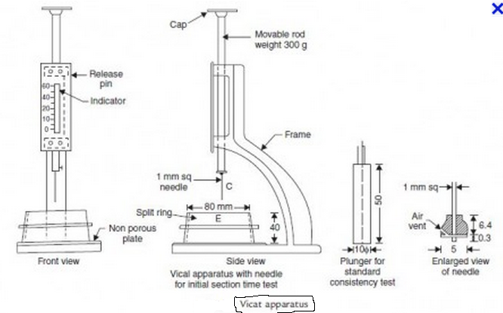
Vicat Plunger

Slide 5
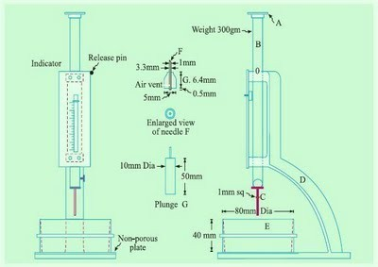
PROCEDURE:
For first trial, take about 500gms of cement & water of 24%by weight of cement.
Fill it in Vicat’s mould.
After filling, shake the mould to expel air.
A standard plunger, 10 mm diameter, 50 mm long is attached and brought down to touch the surface of the paste and quickly released.
Note the reading according to depth of penetration of the plunger.

Slide 6
PROCEDURE:
•
Conduct trials continuously by taking different water cement ratios till the plunger penetrates for a depth of 33- 35mm from top.
This particular percentage is known as percentage of water required to produce cement paste of standard consistency.
This is usually denoted as ‘P’.
λ
λ
^{λ} SUITABLE CONDITIONS:
λ
λ
Conducted in a constant temperature of 270+20C. Constant Humidity 90%.

Slide 7
3. Setting Time Test:
An arbitraty division has been made for the setting time of cement.
Initial setting time &
Final setting time.

Slide 8
INITIAL SETTING TIME
The time elapsed between the moment that the water is added to the cement, to the time that the paste starts losing its plasticity.
Normally a minimum of 30min has maintained for mixing & handling operations.
It should not be less than 30min.

Slide 9
FINAL SETTING TIME
The time elapsed between the moment the water is added to the cement, and the time when the paste has completely lost its plasticity and has attained sufficient firmness to resist certain definite pressure.
It should not exceed 10hours.

Slide 10
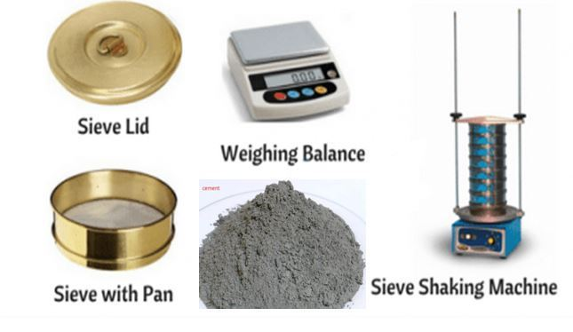
4. FINENESS TEST
•
The Fineness test of cement is done by sieving cement sample through standard IS sieve. The weight cement particle whose size greater than 90 microns is determined and the percentage of retained cement particle are calculated. This is known as Fineness of cement.

Slide 11
5. SIEVE TEST
PROCEDURE:
Take correctly 100grams of cement on a standard IS sieve No.9
Break down the air-set lumps & sieve it &weigh it.
This weight shall not exceed 10% for ordinary cement.
Sieve test is rarely used.

Slide 12
6. SOUNDNESS TEST
λ
It is very important that the cement after setting shall not undergo any appreciable change of volume.
λ
This test is to ensure that the cement does not show any subsequent expansions.
λ
The unsoundness in cement is due to the presence of excess of lime combined with acidic oxide at the kiln.
λ
This is due to high proportion of magnesia & calcium sulphate.
λ
Therefore magnesia content in cement is limited to 6%.
λ
Gypsum 3-5.

Slide 13
APPARATUS FOR SOUDNESS TEST
λ
λ
λ
It consists of a small split cylinder of spring brass. It is 30mm diameter & 30mm high.
Cement is gauged with 0.78 times & filled into the mould & kept on a glass plate & covered with another glass plate.
This is immersed in water at a temperature 27⁰c-32⁰c for 24 hours. Measure the distance between indicators.
Heat the water & bring to boiling point of about 25-30min. Remove the mould from the water after 3 hours.
Measure the distance between the indicators.
This must not exceed 10mm for ordinary, rapid hardening, low heat Portland cements.
If this expansion is more than 10mm the cement is said to be unsound.
λ
λ
λ
λ
λ
λ
λ

Slide 14
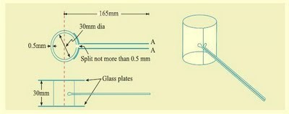
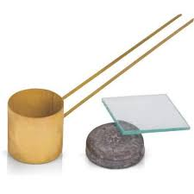
APPARATUS OF SOUNDNESS TEST

Slide 15
7. STRENGTH TEST
This is the most important of all properties of hardened cement.
Due to excessive shrinkage and cracking the strength tests are not made on heat cement paste.
Standard sand is used for finding the strength of cement.

Slide 16
PROCEDURE
Take 555gms of standard sand. 185gms of cement (i.e., 1:3 ratio of cement and sand)
Mix them for 1min, then add water
Mix three ingredients thoroughly until the mixture is of uniform colour.
The time of mixing should not be<3min and >4min.
Then the mortar is filled into a cube mould of 7.06cm and area of 50 cm2.
Compact the mortar.
Keep the compacted cube in the mould at a temperature of 27°C for 24 hours.
After 24hours the cubes are removed & immersed in clean fresh water until taken for testing.
The cubes are tested for compressive stress for 28 days.
λ
λ
λ
λ
λ
λ
λ
λ
λ

Slide 17
8. Heat of hydration
This test method covers the determination of the heat of hydration of a hydraulic cement by measuring the heat of solution of the dry cement and the heat of solution of a separate portion of the cement that has been partially hydrated for 7 and for 28 days, the difference between these values being the heat of hydration for the respective hydrating period.

